Slide 1
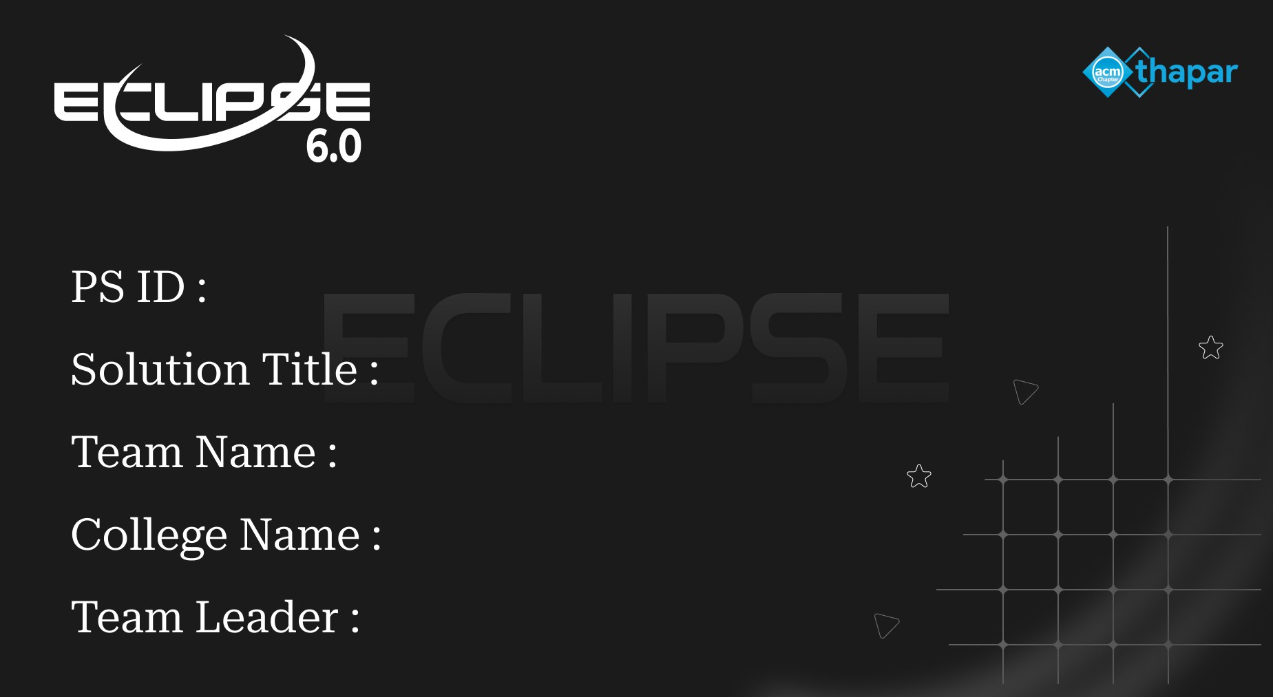
EC603
Open Innovation
BYTEFORCE
Pranveer Singh Institue of Technology
Abhinav Roy

Slide 2

Introduction
1. Cloud computing faces increasing threats from Distributed Denial of Service (DDoS) attacks. 2. Attackers overwhelm infrastructure with massive traffic, causing outages for legitimate users. 3. Traditional methods fall short — AI-powered, multi-layer defense is the modern solution. 4. This project proposes an intelligent DDoS detection & mitigation system for cloud environments. 5. Leverages Machine Learning (ML) models with real-time traffic analysis and automated response.
🛡
🛡

Slide 3
Problem Statement
⚡
🔄
🌐
Volumetric Attacks
Protocol Attacks
App-Layer Attacks
UDP/ICMP floods overwhelm bandwidth, making services unavailable to users.
SYN floods & BGP attacks exploit protocol weaknesses to exhaust server resources.
HTTP floods & DNS amplification mimic legitimate traffic, bypassing simple filters.
⚠ Cloud outages cost businesses millions per hour — intelligent protection is mission-critical

Slide 4
System Architecture
EDGE LAYER CDN · WAF · Load Balancer
98.9%
Random Forest Accuracy
DETECTION LAYER ML Models: RF · LSTM · SVM
99.2%
PROCESSING LAYER Apache Kafka + Spark Streaming
LSTM Accuracy
MITIGATION LAYER Rate Limiting · IP Blacklist · Auto-Scale
<1s
APPLICATION LAYER Kubernetes Cluster · Protected Services
Detection Latency

Slide 5
ML Detection Pipeline
📥
⚙
🤖
⚖
🚨
Traffic
Ingestion
Feature
Engineering
ML
Inference
Decision
Engine
Response
Action
Packet rates
Flow patterns
RF + LSTM
+ SVM Ensemble
Threshold
Scoring
Block / Rate
Limit / Alert
Kafka
Topics
Training Datasets: CICIDS2017 · CICIDS2018 · CICDDoS2019

Slide 6
Technology Stack
Cloud Platform
Container Orchestration
AWS / Azure · VPC · Security Groups
Kubernetes · Horizontal Pod Autoscaling
Message Streaming
ML Frameworks
Apache Kafka · High-throughput topics
TensorFlow · PyTorch · Scikit-learn
Data Processing
Monitoring
Apache Spark · Spark Streaming
Prometheus · Grafana · ELK Stack

Slide 7
Mitigation & Response Flow
Traffic Detected
YES
ML Model Scores > Threshold?
NO
ATTACK DETECTED
Normal Traffic
Allow through · Log event
Continue monitoring
IP Blacklisting Rate Limiting Traffic Diversion Auto-Scaling Triggered
Alert System: Email Notifications · Slack Integration · Tiered Escalation Procedures

Slide 8
Conclusion
Multi-Layer Defense
AI-Powered Accuracy
✅
🤖
Combines CDN, WAF, and ML-driven detection for comprehensive cloud protection.
.
LSTM achieves 99.2% detection accuracy with sub-second response latency.
Adaptive & Scalable
Continuous Learning
📈
🔁
Kubernetes auto-scaling ensures uptime even during massive volumetric attacks.
Models retrain on new attack data, staying effective against evolving threats.
BYTEFORCE · Pranveer Singh Institute of Technology · Eclipse 6.0

